Slide 1
Introduction to Quantum Computing: From a Layperson to a Programmer in 30 Steps
Hiu-Yung Wong
https://link.springer.com/book/10.1007/978-3-030-98339-0
https://www.amazon.com/Introduction-Quantum-Computing-Layperson-Programmer/dp/3030983382
Playlist: https://www.youtube.com/watch?v=QQS5il0LH1I&list=PLnK6MrIqGXsJfcBdppW3CKJ858zR8P4eP&index=39
https://www.youtube.com/watch?v=BSz2ZmVAnyI&list=PLnK6MrIqGXsJfcBdppW3CKJ858zR8P4eP&index=40

Slide 2
Quantum Algorithm

Slide 3
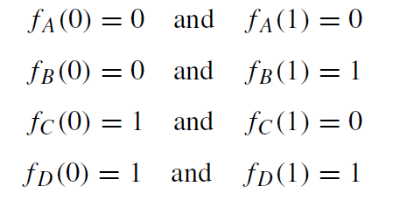
Deutsch’s Problem
Finding if a function balanced or constant?
Boolean function:
f : {0, 1} → {0, 1}
Constant
balanced
balanced
Constant
Classically, 2 computation, f(0) and f(1) QC, do this in 1 computation.

Slide 4
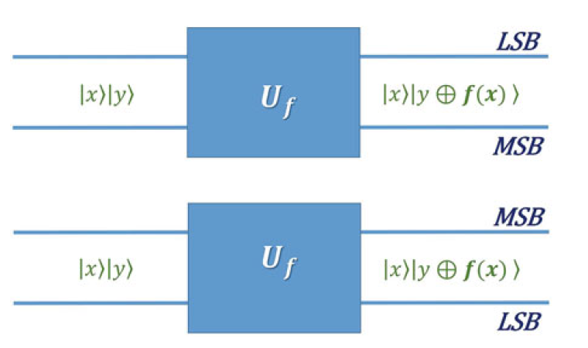



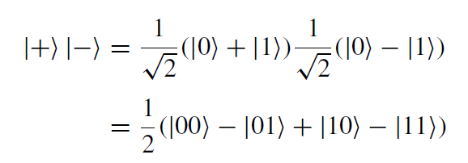
Deutsch’s Algorithm (overview)
Step 0: Create a Quantum Oracle (Encode the Problem)
Ex :- If |x⟩ = |1⟩
|y⟩ = |1⟩
If f(x) = 1
Step 1: Create a Superposition Input = |0 1 ⟩ = |1⟩

Slide 5
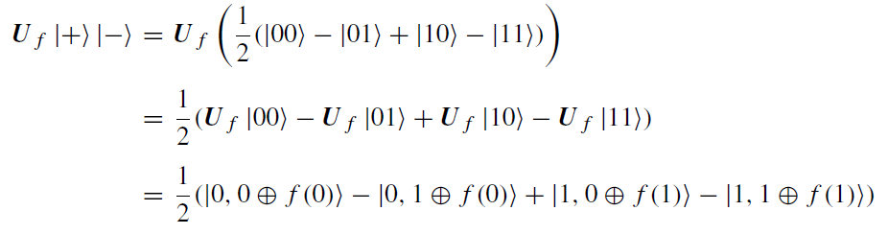

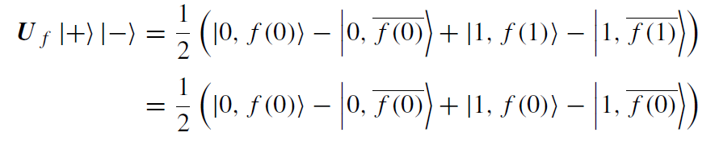

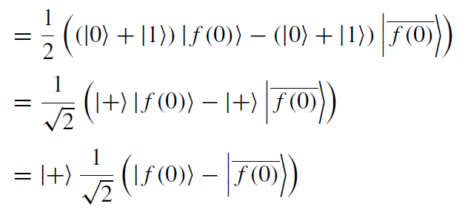
Step 2: Evaluate Using the Quantum Oracle (Parallelism)
|x, y f(x) ⟩
Step 3: Measure on the Right Basis to Get the Answer (e.g. if it is constant (deterministic output))

Slide 6

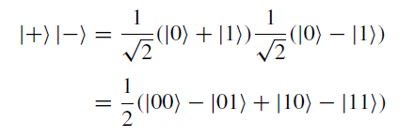
Deutsch’s Algorithm
1) Implement unitary gate (quantum oracle)
2) Prepare

Slide 7
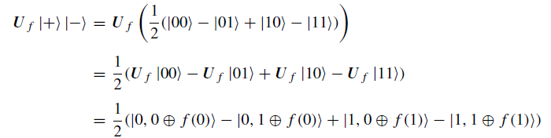

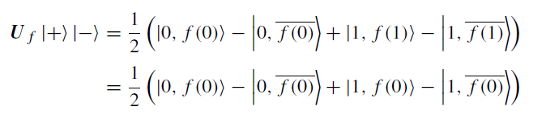
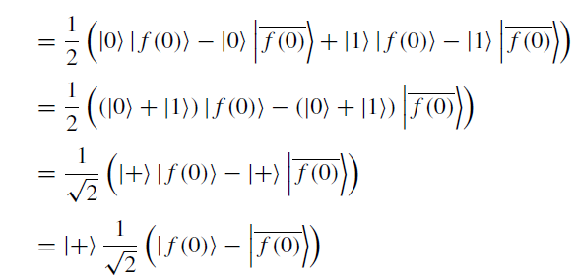
3)
4)

Slide 8



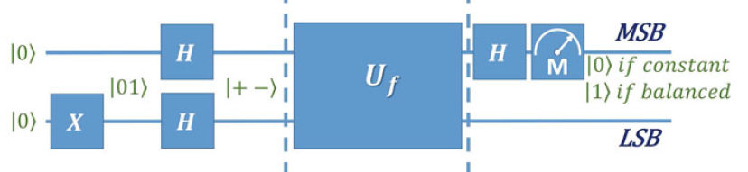

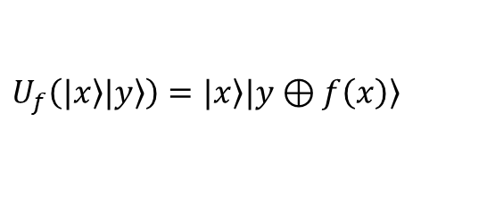

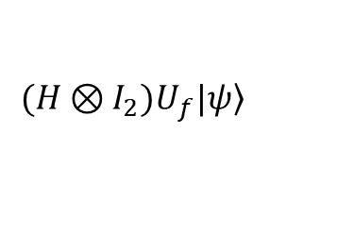
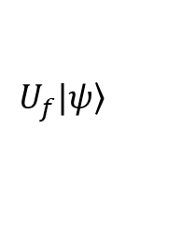
Deutsch’s Algorithm
Quantum gate:
$$U_{f}\left(|\left.x\right\rangle |\left.y\right\rangle \right)=|\left.x\right\rangle |\left.y⊕f\left(x\right)\right\rangle$$
Prepare Initial State:
$$|\left.ψ\right\rangle =\frac{1}{\sqrt{2}}\left(|\left.0\right\rangle +|\left.1\right\rangle \right)⊗\frac{1}{\sqrt{2}}\left(|\left.0\right\rangle −|\left.1\right\rangle \right)=|\left.+\right\rangle ⊗|\left.−\right\rangle$$
Operation (parallelism):
$$U_{f}|\left.ψ\right\rangle$$
Operation (prepare to measurement in |+>|-> Basis
$${(H⊗I_{2})U}_{f}|\left.ψ\right\rangle$$
Measurement 1st bit: If $|\left.0\right\rangle$, constant; If $|\left.1\right\rangle$, balanced;
is
is

Slide 9
Circuit for Deutsch’s Algorithm
I give you 2 minutes to draw the circuit

Slide 10
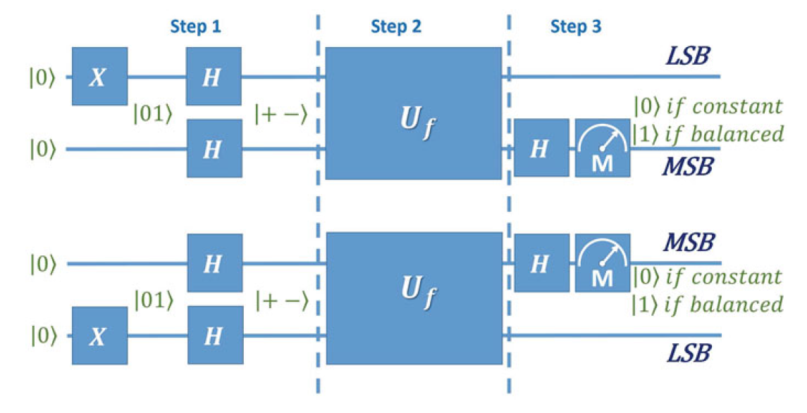
Circuit:

Slide 11
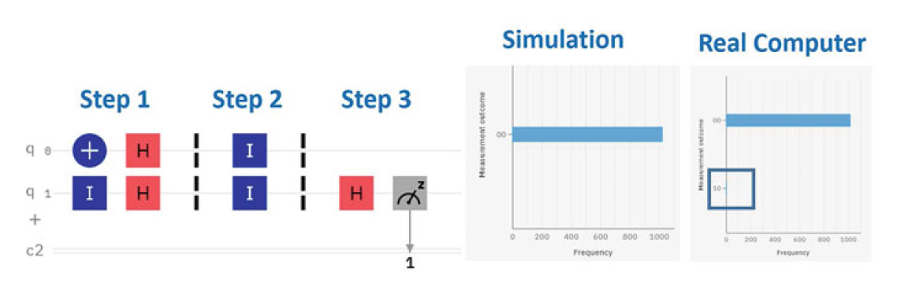
IBM-Q

Slide 12
Quantum Oracle
- A black box which contain the information of f(x) related to the problem to be solved
- Unitary gate - reversible

Slide 13
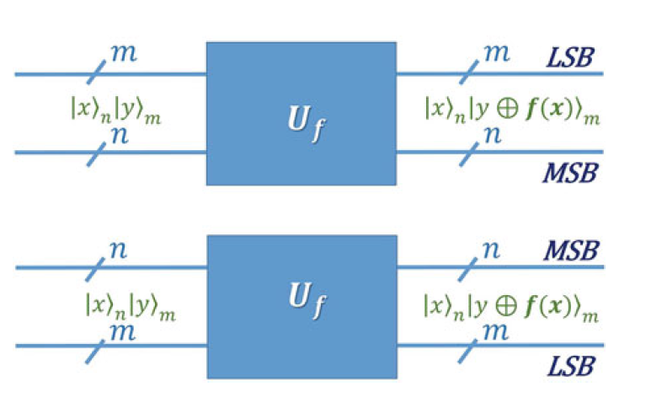

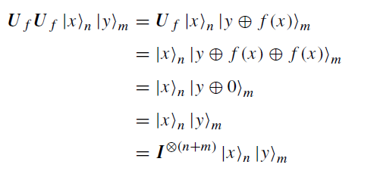




XOR Oracle
$$f:{\left\{0,1\right\}}^{n}⟶{\left\{0,1\right\}}^{m}$$
Advantages:
Input and output have the same number of bits (n+m)
Reversible by construction
To prove it is unitary, see Q22.2 in chapter 22 in the textbook.

